Slide 1


Breast Cancer Detection using Transfer Learning Techniques in Convolutional Neural Networks
Paper Accepted : EAIT 2022 Conference
will be published by Springer Nature book series
“Lecture Notes in the Network and Systems”
Presented By
RANDRITA SARKAR

Slide 2
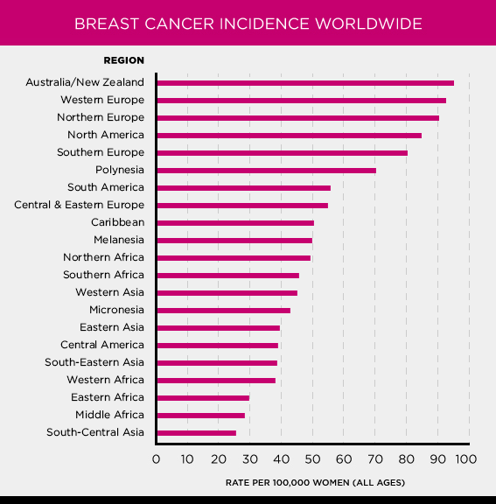


Slide 3



Research Domain
We worked on the transfer learning approach to reach highest accuracy in prediction.
We built two models, one is using ResNet152V2 and another one is on Inception-V3

Slide 4
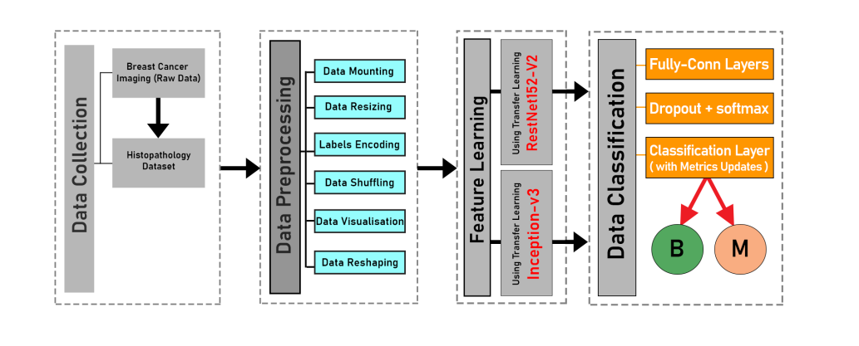

Slide 5


Slide 6
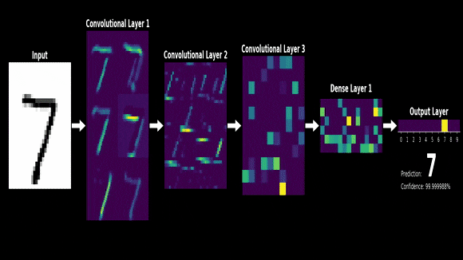

Slide 7




Slide 8
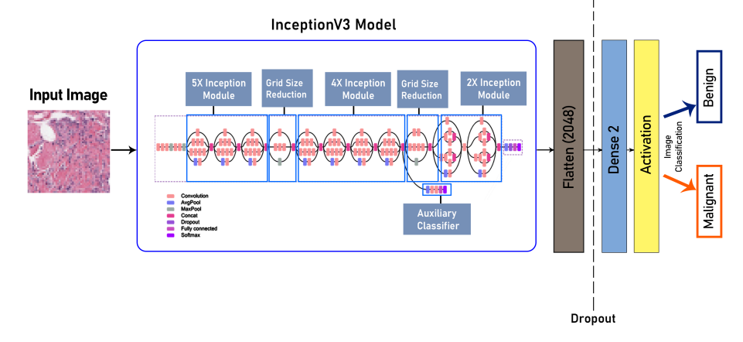

Slide 9
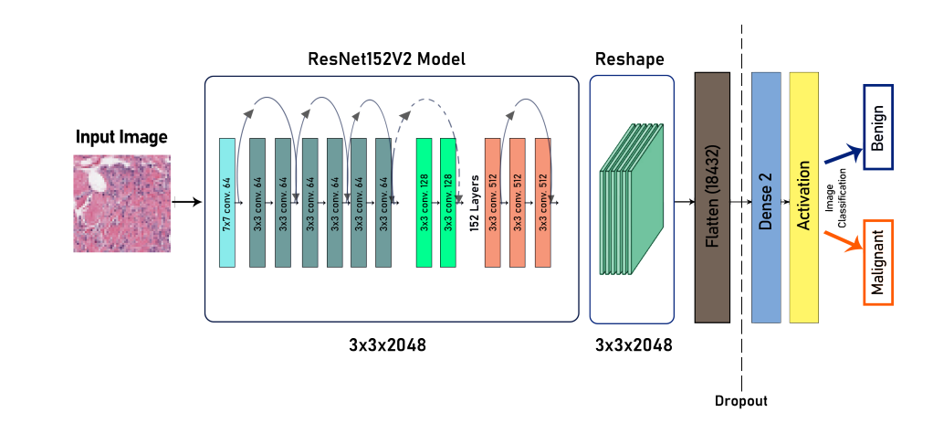

Slide 10
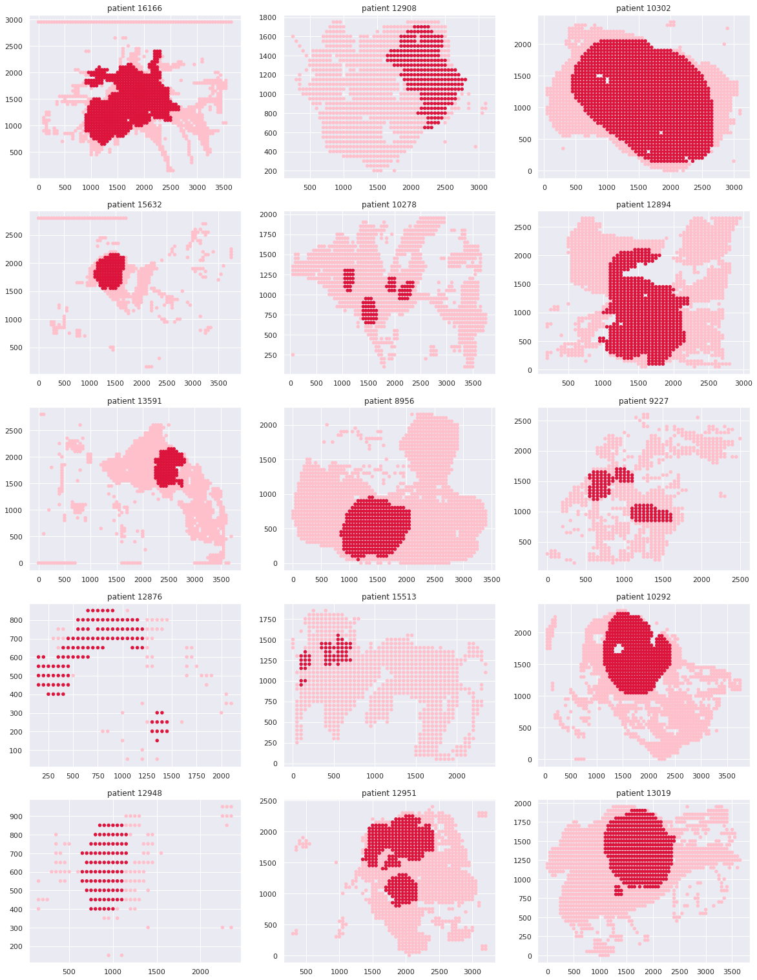
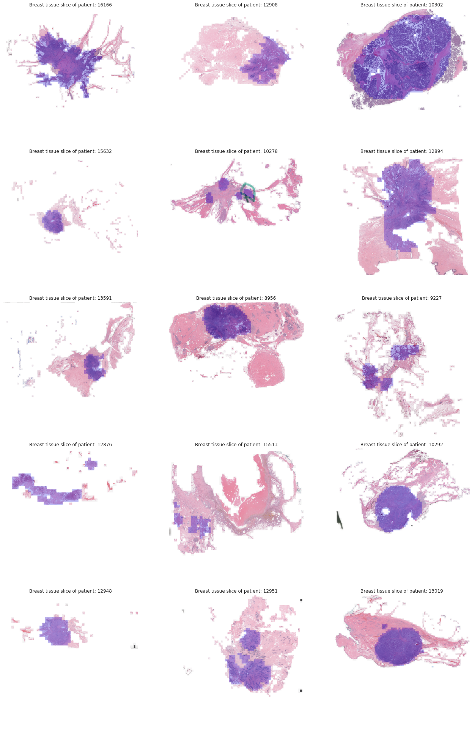
Detected Patches By the model

Slide 11
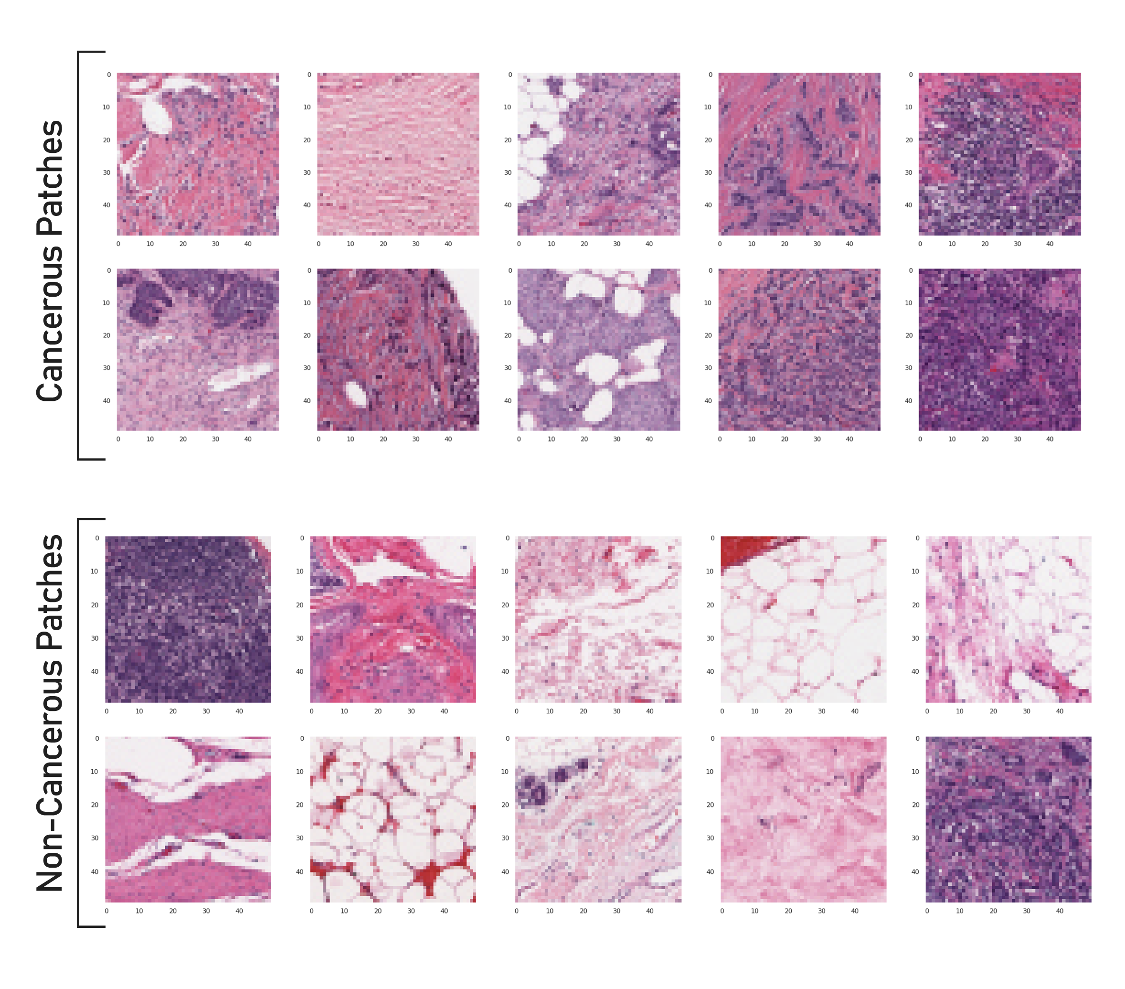

Slide 12
Conclusion:
This paper presents a transfer learning-based strategy for classifying HEstained histological breast cancer images. Google’s Inception-V3 and residual network (ResNet152V2) designs, which have been pre-trained using ImageNet, are used to teach the network features. Both the networks have been trained with 70% of the data set, and their performance was evaluated on the remaining 30% of images. For the automatic analysis of breast cancer histology images, the given study illustrates the applicability and powerful classification capacity of transfer learning algorithms.

Slide 13
Thank You !
IT PROJ-CS601 TH

